Slide 1
Complete Competitive Programming Course
by
Muhammad Shahriar Alam

Slide 2
Module : 1
C/C++
Basic I/O
Operators ( +, -, *, /, &, |, ^ )
Conditions ( if/else )
Loops ( for, while, do-while )
Array/Strings
Greedy
Bruteforce
Constructive
Functions
Built in functions both C and C++

Slide 3
Class Topics
Introduction to the course
Introduction to computer programming
Introduction to C programming
Importance of Programming and problem solving
What is a programming Contest and Importance of it?
Writing your first program “Hello world”
A. I will be the one ( CodeMarshal )
https://algo.codemarshal.org/contests/icpc-dhaka-20/problems/K
Practice Problems ( Assignment ) :
A. Welcome ( CodeMarshal )
1000. Hello World! ( beecrowd )
All discussed problems in class

Slide 4
Course Materials
Discord
Google Classroom
Google Calendar Event

Slide 5
What is Computer Program and Programming?
Computer Program is the Life of a computer.
Windows
Linux
Calculator
Game
Google
Facebook
Websites (Amazon, Alibaba etc.)

Slide 6
What is programming language?
C
C++
Java
Python
C#
JavaScript
But HTML and CSS?

Slide 7
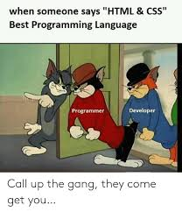
HTML is not a programming language

Slide 8
What is Competitive programming?
Sports Programming
Problem solving
Programming Contest
Online Contest (Codeforces, Atcoder, Codechef, Facebook Hacker Cup, Snack Down )
Onsite Contest ( Divisional, NCPC, ICPC Regional, ICPC west finals, ICPC World Finals )
Interview Questions becomes easy (Google, Amazon, Facebook, Microsoft etc)
And the most import : it is Fun (Pera nai chill)

Slide 9
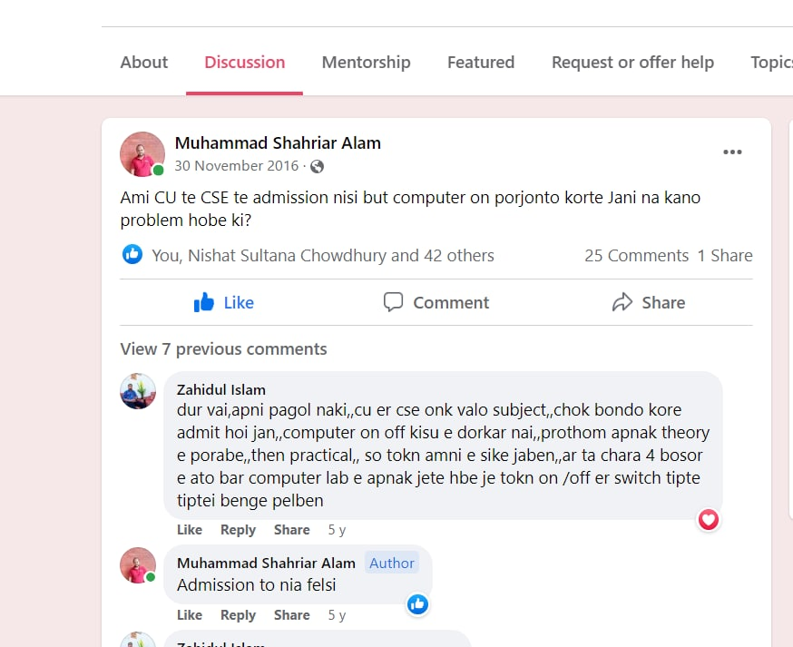
How a bad student became a Good Software Engineer

Slide 10
My Life Story
Bad student
Don’t love to read but love to do math
Done well in SSC but didn’t get admission any good collage.
Worked hard on inter and get admitted to CU CSE
Start Friendship with Mohaimin but refused to do Programming
Start programming on Mobile problem with copy paste
Lack of internet up to 2 years
3 year no improvement and no money to join onsite
And finally the 4th year. Alhamdulillah the Golden time of my CP life

Slide 11
What is Online Judge
BeeCrowd
Codeforces
Atcoder
Codemarshal
LightOJ
LeetCode
Timus
Uva
SPOJ
CSES
Codechef

Slide 12
Online Contests
Codeforces ( Div-4, Div-3, Div-2, Div-1)
Atcoder ( ABC, Regular, Grand )
CodeChef ( Cookoff, Lunch, Long, Starter )
LeetCode ( Weekly, Biweekly )
Facebook Hacker Cup
Codechef Snackdown

Slide 13
Onsite contest
Divisional
Onsite Contest
IUPC
NCPC
ACM ICPC Dhaka Regional
ACM ICPC World Finals

Slide 14
What is the benefit of Programming Contest
It’s fun
Improves Problem Solving Skills
Improve Logic
Job Interview Call
Easily Crack BD Job Interview Crack
Feel Confident
Scholarship
Cracking Google is not that much hard for an hardcore competitive programmer

Slide 15
More Links
cf-visualiser
stopstalk
Paste Ubuntu
Linkedin
GitHub
Shafets planet
Emaxx
https://cp-algorithms.com/

Slide 16
Which language should I chose?
C/C++
Codeblocks

Slide 17
How to get best out of this course
Attend daily class
Submit assignment regularly
Solve at least 4-5 problems on Codeforces of you max rating
Very Beginner’s will solve BeeCrowd upto 70 problems
Solve at least 1 problem on your highest busy schedule
Make a havite of problem solving
Take Problem solving as a passion
Attend programming contest regularly
Be consistent
Remember : Motivation will come and go, Habit of problem solving will always remain with you InShaALLAH

Slide 18
Be Consistent, Work Hard, Depend on ALLAH, Pray your Salah, Recite Quran Regularly.
InShaALLAH one day Success will be yours

Slide 19
Programming is not a subject it is a passion,
Contest is not an exam, it is a game.

